Slide 1

ICT Learning Centre @ UL - Python and ML Foundations
Python – Functions

Slide 2



Functions
Package Your Power

Slide 3

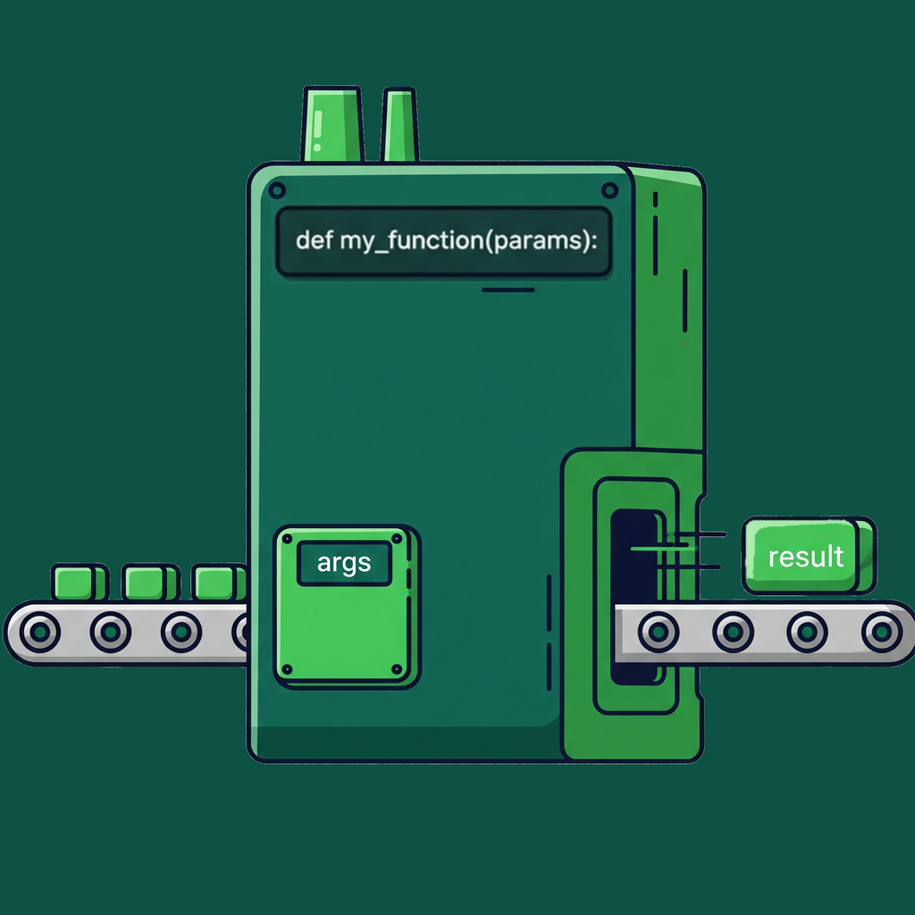
What are functions?
Block of code which only runs when it is called.
Data known as parameters can be passed into a function.
Can return data as a result (not mandatory).

Slide 4
Why use functions?
Reusability: Write code once, use it everywhere.
Organization: Break down complex problems into smaller, manageable chunks.
Readability: Give a name to a block of code, making your logic easier to follow.

Slide 5
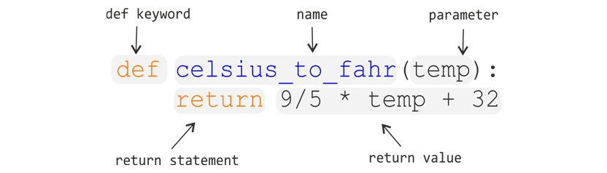
Anatomy of a function

Slide 6
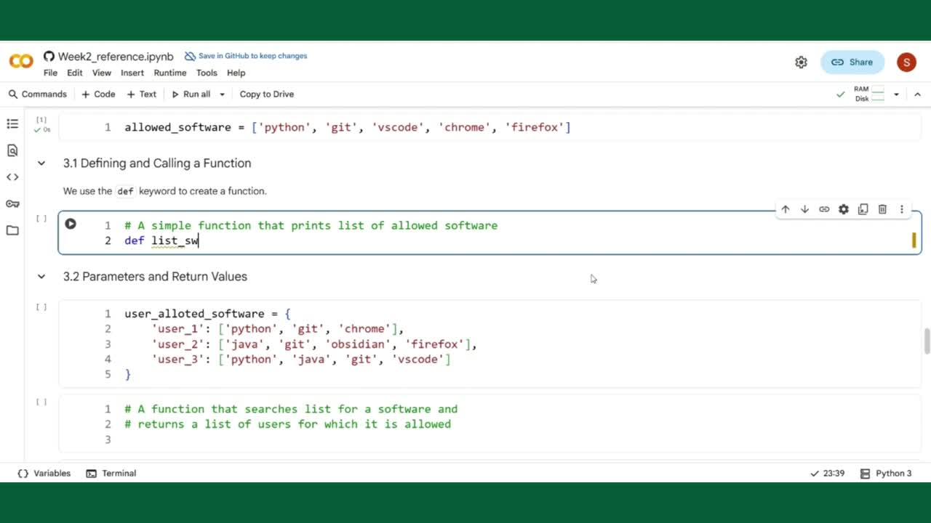

Slide 13
Parameters
vs
Arguments
# Function definition
def foo(param1, param2):
# Do something
# parameters are placeholder variables
# Call the function
foo(10, 20) # example arguments i.e., actual values

Slide 14
The return Statement
# Function definition
def foo(param1, param2):
return param1 + param2 # result of function returned
# Call the function
result = foo(10, 20) # result stored in variable, `result`

Slide 15
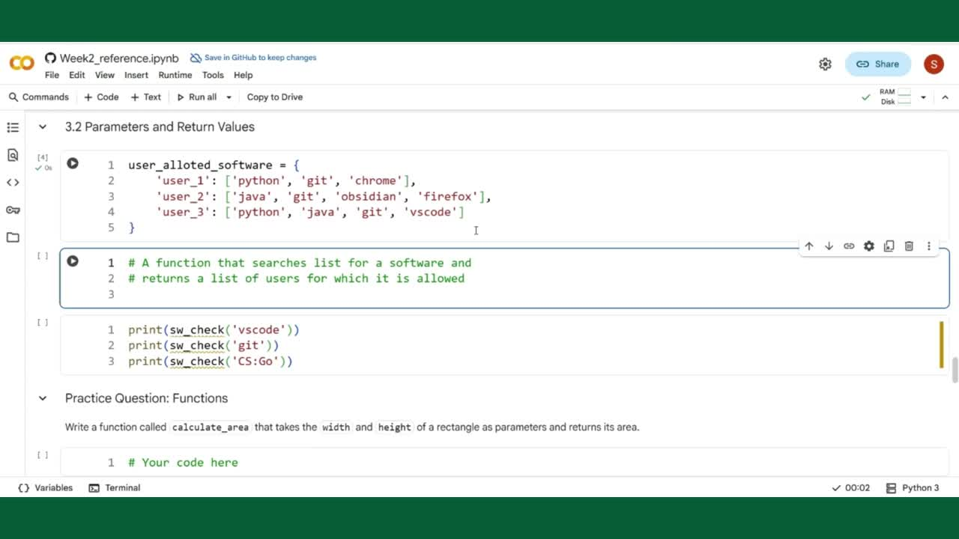

Slide 17
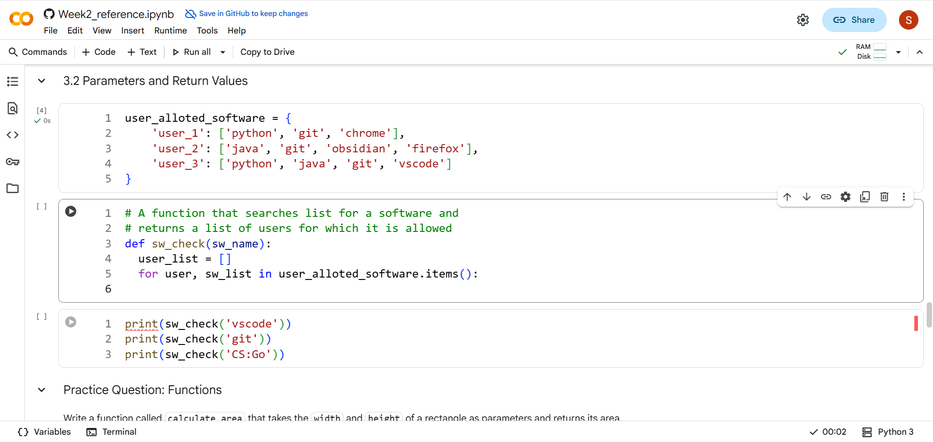
:)

Slide 18

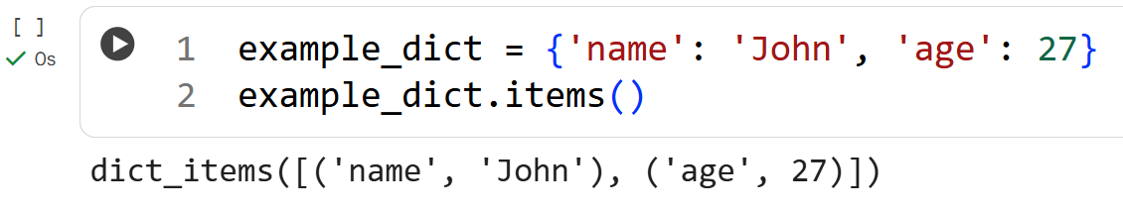
dict.items()
Returns a list of key-value pair tuples

Slide 19
?

Slide 20
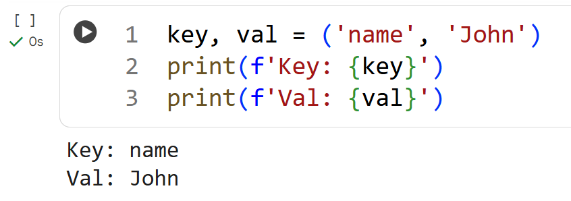
Unpacking in Python
Assigns values from collection to corresponding variables

Slide 23
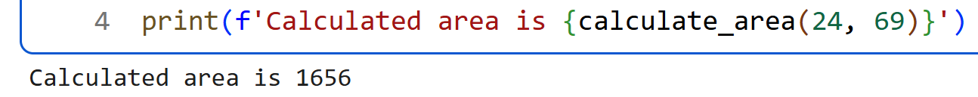
Practice Question
Expected Output

Slide 24

ICT Learning Centre,
CS1-046,
CSIS Building,
University of Limerick,
http://ictlc.ul.ie/contactus
Thank you

